Slide 1
Spanish Learn
Mark shen

Slide 2
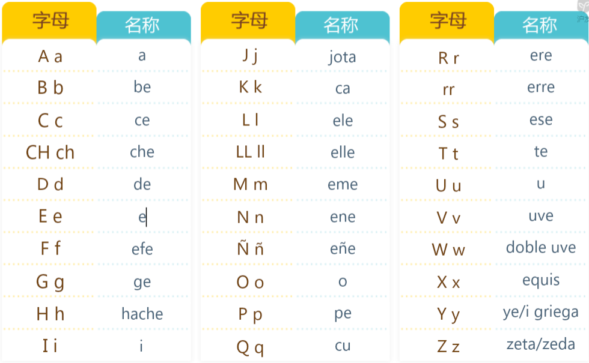
发音

